Slide 1
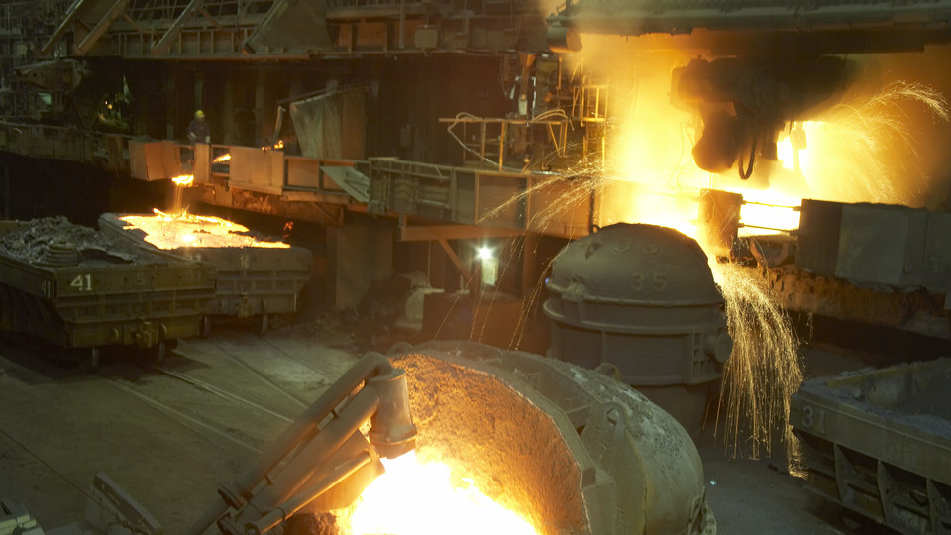
The Single Temperature Stop Work Challenge
Dr Ross Di Corleto

Slide 2
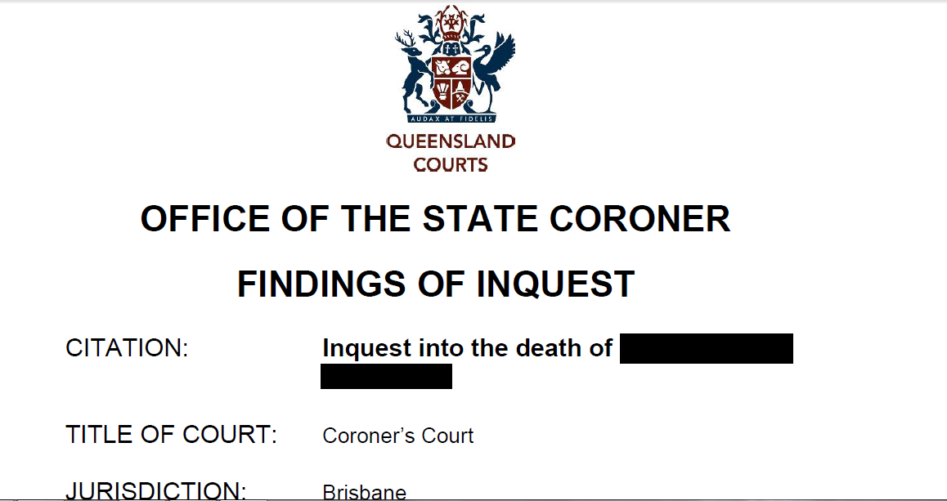
2013 Heat Stress Fatality

Slide 3
One of the Coroner’s findings
Recommendation 2: “I recommend that any future industry-wide code of practice should be based on a quantitative assessment of climate, including an ultimate cut-off temperature at which work must cease.……..”
Is this practically achievable?

Slide 4
Key variables that must be considered
Environmental contributions to heat illness
Personal factors which influence heat illness

Slide 5
Environmental Contributions to Heat Illness
  Temperature
  Humidity
  Air Movement
  Radiant temperature of surroundings
  Clothing
  Physical activity
Notes:
This overhead illustrates some of the environmental factors that must be considered.

Slide 6
Personal Factors Which Influence Heat Illness
  Age
  General Health
  Weight & Physical fitness
  Hydration State
  Acclimatisation
  Drugs
Notes:
And here are some of the personal factors that effect how a person will cope with the heat.
Age
Generally the very old and the very young are more prone to heat illness
General Health
Personnel suffering from colds or viruses or who are dehydrated due to illnesses are more likely to suffer from exposure to hot environments
Weight and Physical Fitness
A person is more prone to the affects of heat strain if they are overweight and generally unfit.
Hydration State
If you are already dehydrated before you start your health will decline rapidly.
Acclimatisation
The bodies acclimatisation to the climate is also very important and shall be dealt with more fully later in this session
Drugs
Many drugs will affect how the body copes with heat. Ie. Diuretics effect fluid loss: antidepressants in high doses can bring on hyperthermia as can cocaine; cannibis increases the risk in hot environments; amphetamines can result in vaso-constriction.

Slide 7
So how far out can you be if you choose one temperature?
Let’s look at some scenarios

Slide 8
Estimation Exercise
Scenario | Air Temperature °C | Allowable Exposure Time (AET) Estimated | Allowable Exposure Time (AET) Calculated
1 | 34.0
2 | 32.0
3 | 40.9
4 | 52.4
Choose an exposure time from the list below for each of the scenarios based only on each of the air temperatures in the table above.
No Limit
60 Min
30 Min
15 Min
No Work

Slide 9
Group assessment exercise
Most often the single most used temperature to stop work is the air temperature or dry bulb.
  Let’s do some additional monitoring and utilise a Rational heat stress index such as ISO 7933 Predicted Heat Strain (PHS)
  globe temperature,
  air velocity,
  humidity,
  metabolic load
  clothing, and
  posture.
Notes:
The Stage 2 assessment necessitates additional ‘specialist’ monitoring to ensure that the additional basic thermal parameters are measured, that is dry bulb, wet bulb, globe temperature, air velocity, humidity, metabolic load and clothing. This information is then utilised in a more comprehensive rational heat stress index, such as the ISO 7933 Predicted Heat Strain or equivalent (eg. TWL). While such indices are complex and involve upwards of 30 formulae to arrive at the final result, there are computer programs readily available to perform the calculations. One such program has been developed by Professor Jacques Malchaire (http://www.deparisnet.be/chaleur/Chaleur.htm#anglais) and Rio Tinto.
Also available for use at this stage is a heat stress risk assessment checklist (see Documentation appendix), which identifies additional hazards that should also be considered at this point.
Have a copy of the Risk Assessment Checklist as an OH available.

Slide 10
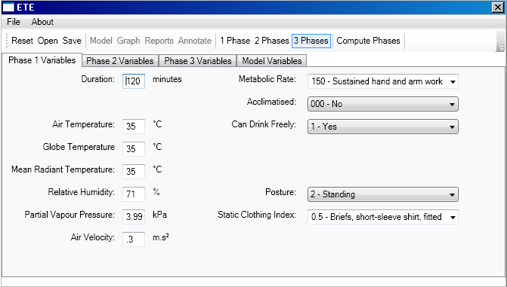
ISO 7933 Predicted Heat Strain Program

Slide 11
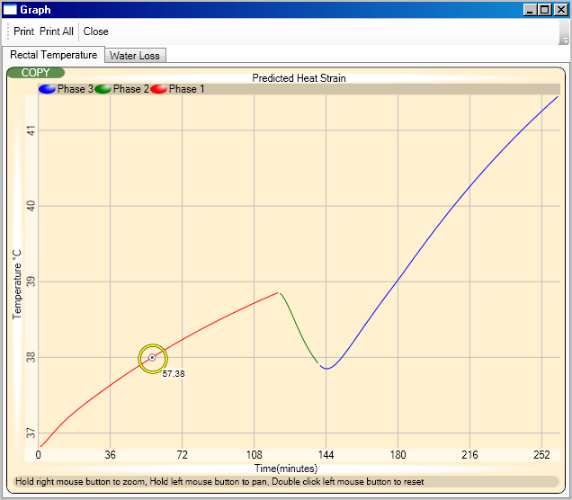
Output Example

Slide 12
Scenario 1: Fruit Picker
A newly arrived British backpacker picking fruit in Queensland.
They work for approx 90 minutes and then stop for a 15 minute break.
Heat stress training provided is: “drink water, wear a hat and use sunscreen”.
Picker has drink container with her
Cooled environment is 200 metres away so break is taken under closest shady tree (<10m)
Work involves picking fruit from tree that machinery has missed but all at ground level in part shade.
Mainly hand arm work, moderate intensity.
Light breeze blowing
Wearing light summer clothes, shorts & T-shirt
1 1/2 hr shift, Ta = 34C; RH= 20%
Notes:
Scenario 2
It is obvious that the work environment in this situation is quite hostile as employees are quite distressed.
In such a situation it is not necessary to go through the process of utilising the basic thermal risk assessment as it is obvious there is a problem.

Slide 13
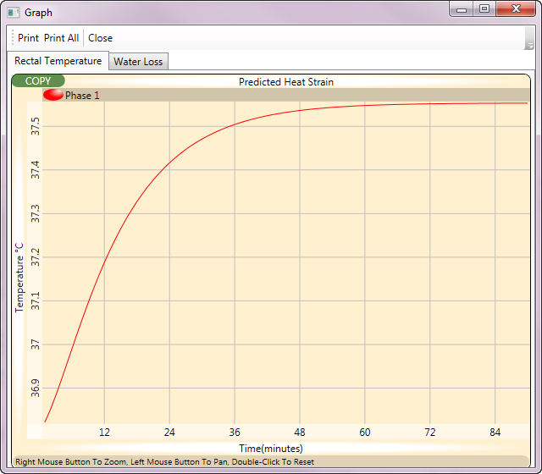
PHS Predicted Core temp

Slide 14
Scenario 2
While having lunch there is a sudden downpour that lasts for 30 minutes.
When the pickers return to work the ambient environment has changed.
Air temperature has dropped to 32C and relative humidity has increased to 80%
Do we need to do anything?

Slide 15
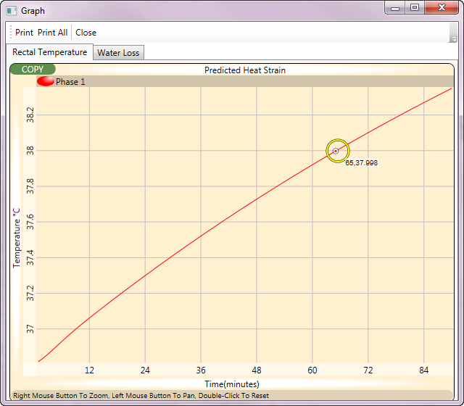
PHS Predicted Core Temperature Graph
Predicted core temperature is above 38.0C after an hour so no longer acceptable without additional controls.

Slide 16
Scenario 3
An emergency services member is attending a potential spill scenario in a chemical storeroom which is an unventilated shipping container.
It is estimated that it will take approx 2 hours to clean up but may take longer.
Notes:
Scenario 2
It is obvious that the work environment in this situation is quite hostile as employees are quite distressed.
In such a situation it is not necessary to go through the process of utilising the basic thermal risk assessment as it is obvious there is a problem.

Slide 17

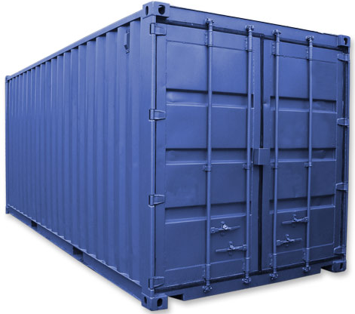

Slide 18
Monitored Parameters
Dry Bulb = 40.9
Globe = 45.3
Rel Humidity = 22.6%
Air Velocity = 0.2 m/s
Metabolic Load = 175 W/m²
Posture = Standing
Clothing is a single layer disposable cotton overalls with an insulation factor of 0.8 clo
Acclimatised worker

Slide 19
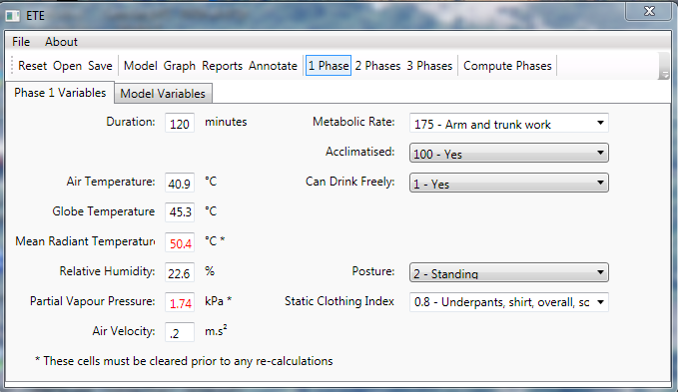
PHS Calculation
Notes:
This is graphically illustrated on this diagram where the core temperature climbs uninterrupted to 39.3 C for the acclimatised worker. This is obviously unacceptable as it will place the individual at a serious risk.

Slide 20
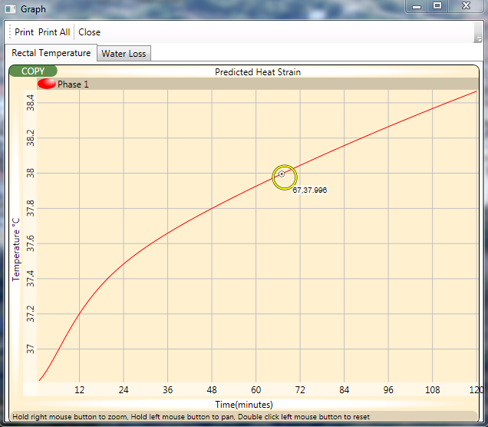
PHS Graph
Is this acceptable? Do we need to do anything?

Slide 21
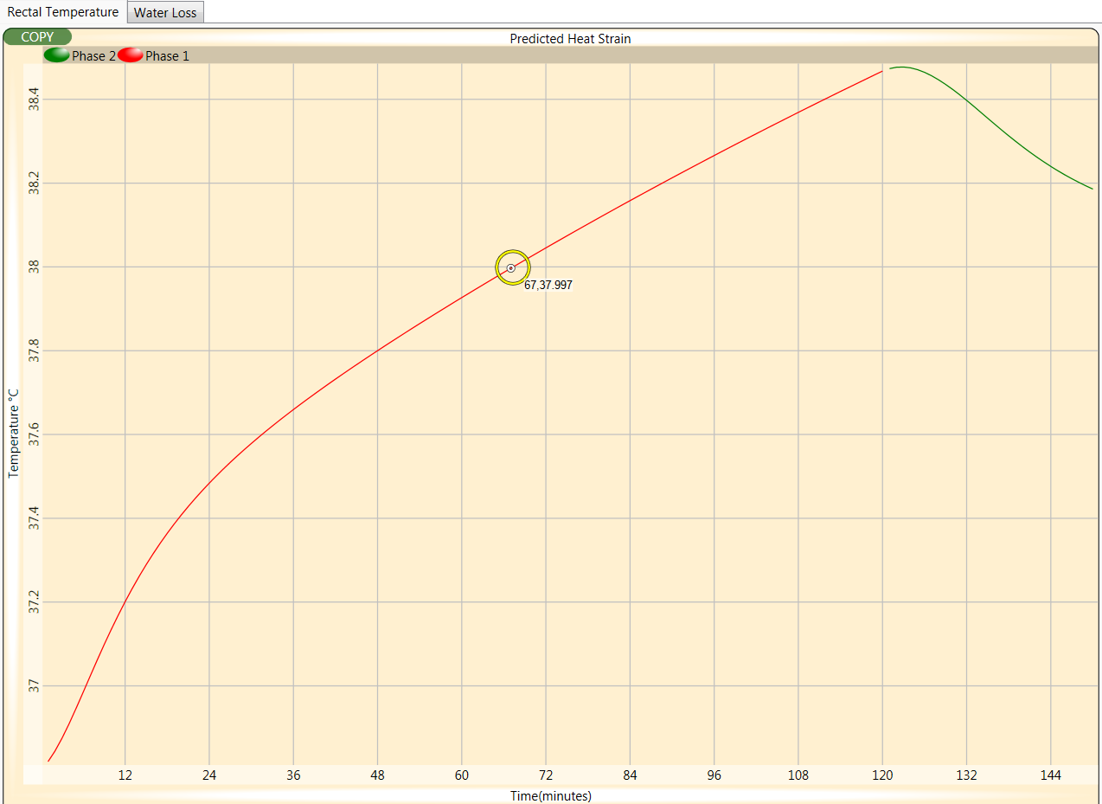
30 Minute Break in work environment

Slide 22
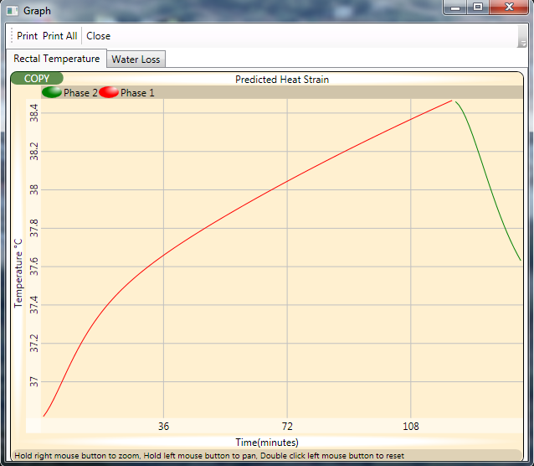
30 Minute break in air conditioned room
So what happens when we put him back to work?
Notes:
Assume that it has been decided that a 30 minute rest break in an air conditioned room is taken. How does this affect the recovery pattern?

Slide 23
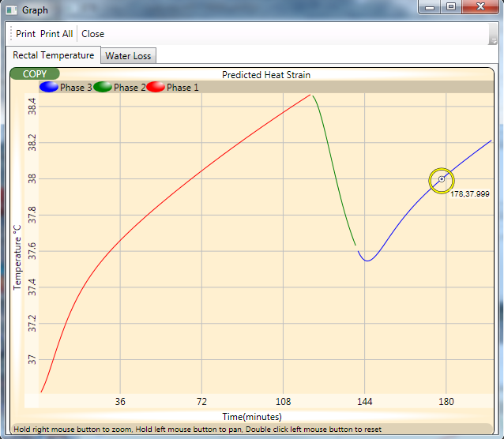
Back to Work after break
Is this acceptable? Workable? Other approaches?
Notes:
The diagram above does show a marked reduction in the core temperature but even after 30 minutes rest in the air-conditioned room the core temperature climbs quickly back up to above the WHO 38ºC.
So what should be done?
The rest break should be taken earlier at approximately 45 minutes into the work cycle and could be reduced to 15 minutes.

Slide 24
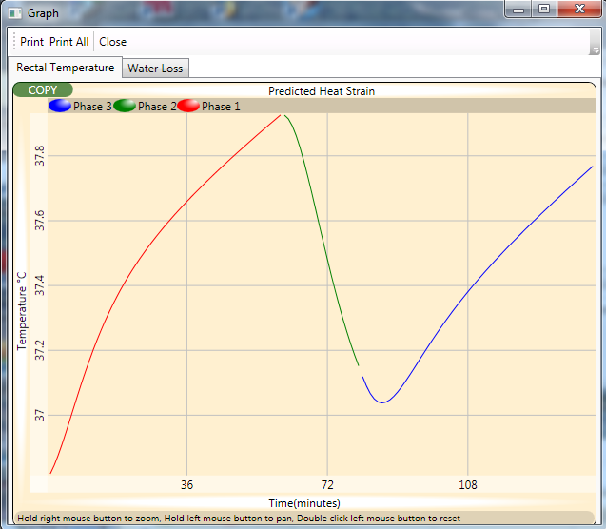
30 Min Break after 60 minutes then back to work*
Any other ideas?
Notes:
As we can see in this diagram, it has effectively reduced the strain on the employee. Caution should be exercised however as at this point they have not recovered to their baseline level and if the individual returns to the same work environment there is a potential that they may exceed the limits.

Slide 25
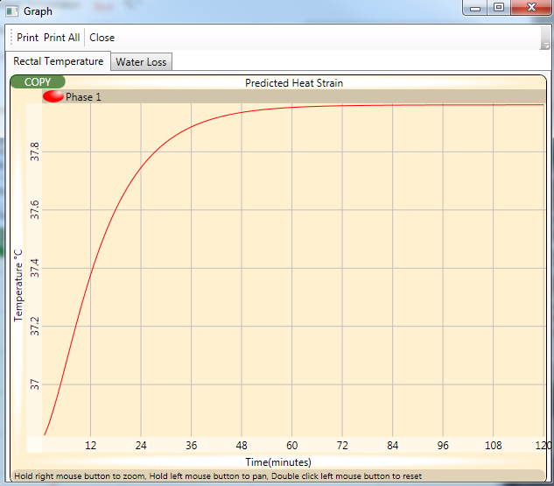
Increased air flow

Slide 26
Scenario 4
Electrician replacing light globes in a very hot (50+°C) storage shed at refinery.
Task takes approx 90 minutes
Requires some climbing up & down a step ladder to reach globes 2 metres high.
Workers have ready access to fluid replacement.

Slide 27
Environmental parameters
Dry Bulb = 52.4°C
Globe = 52.5°C
Rel Humidity = 8.1%
Air Velocity = 0.4 m/s
Metabolic Load = 145 W/m²
Posture = Standing
Clothing is a single layer =0.8 clo
Acclimatised worker

Slide 28
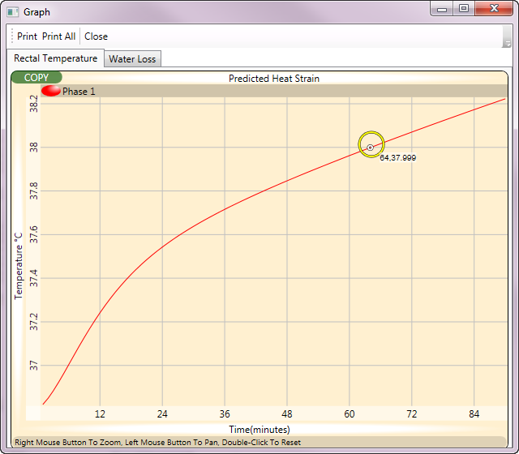
Suggestions? Should we increase the air flow?

Slide 29
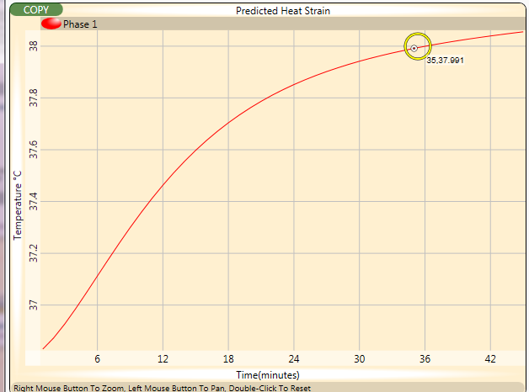
Increase airflow from 0.4 to 2m/s
The situation is now worse. Why?
Increasing the airflow has actually increased the heat load to a level above which the increased evaporative cooling can compensate.

Slide 30
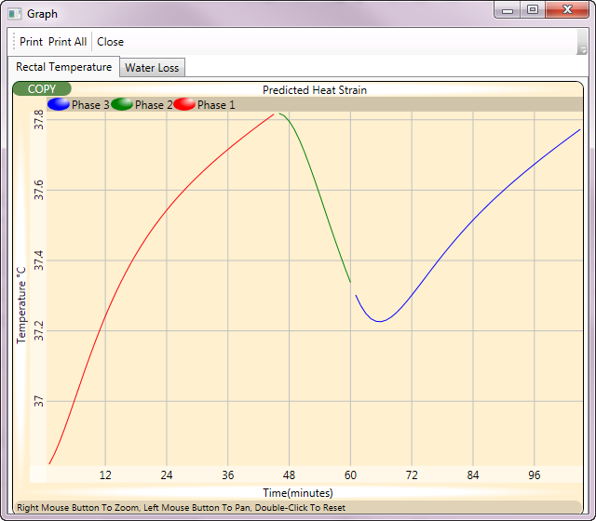
Break in a crib room for 15 Min

Slide 31
Estimation Exercise. How did you go?
Scenario | Air Temperature °C | Allowable Exposure Time (AET) Estimated | Allowable Exposure Time (AET) Calculated
1 | 34.0 |  | No Limit
2 | 32.0 |  | 65
3 | 40.9 |  | 67
4 | 52.4 |  | 64
No Limit
60 Min
30 Min
15 Min
No work

Slide 32
What about heat stress indices?
The ideal heat stress assessment method will need to consider all aspects of heat generation inside the body and the transfer of heat with the work environment.
But which one, over the last 70+ years there have been over 100 different climatic heat stress indices developed.
None of these can take into account all of the personal factors.

Slide 33
Can the Coroner’s recommendation be achieved?
……an ultimate cut-off temperature at which work must cease.……..”
There are far too many variables to be able to define a limit by a single parameter.
Heat stress indices allow the integration of many parameters into one figure but even they cannot account for all scenarios. They cannot guarantee a safe/unsafe limit.
At best they can be used as guides only.

